Slide 1


Slide 2
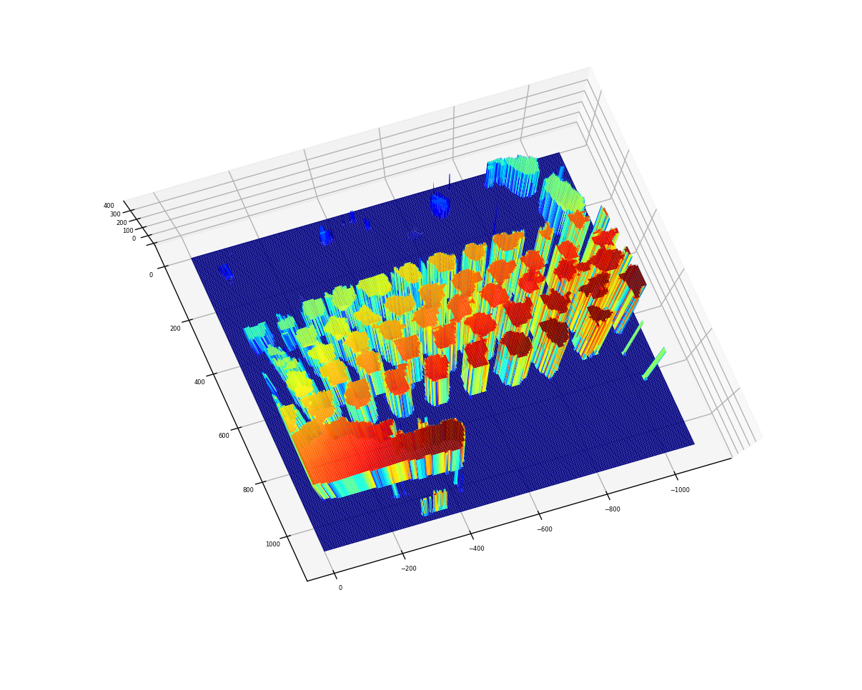
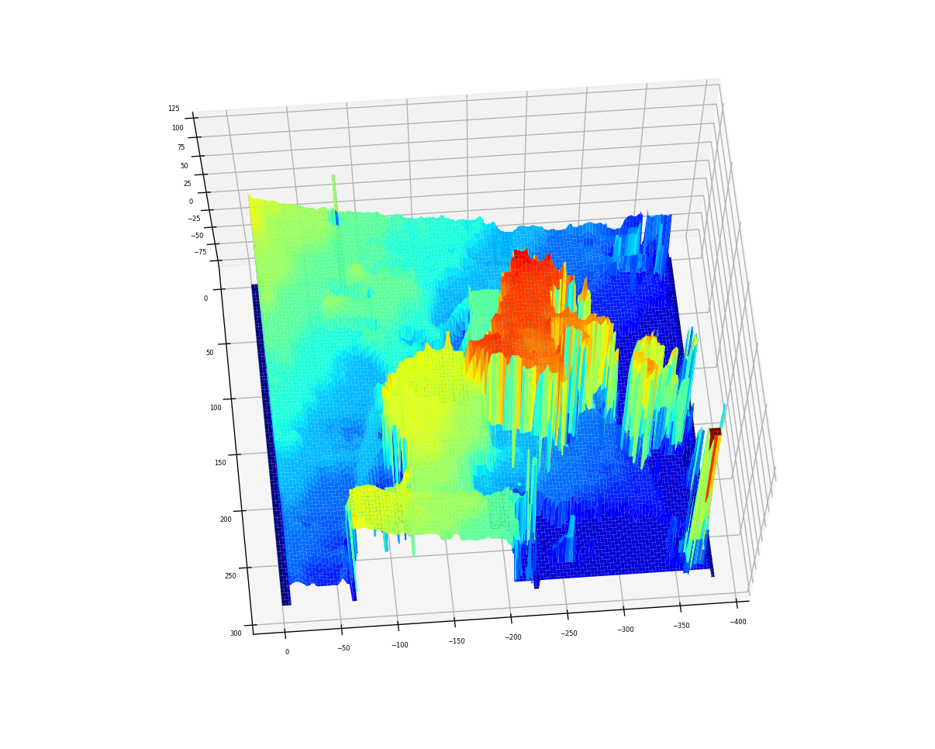
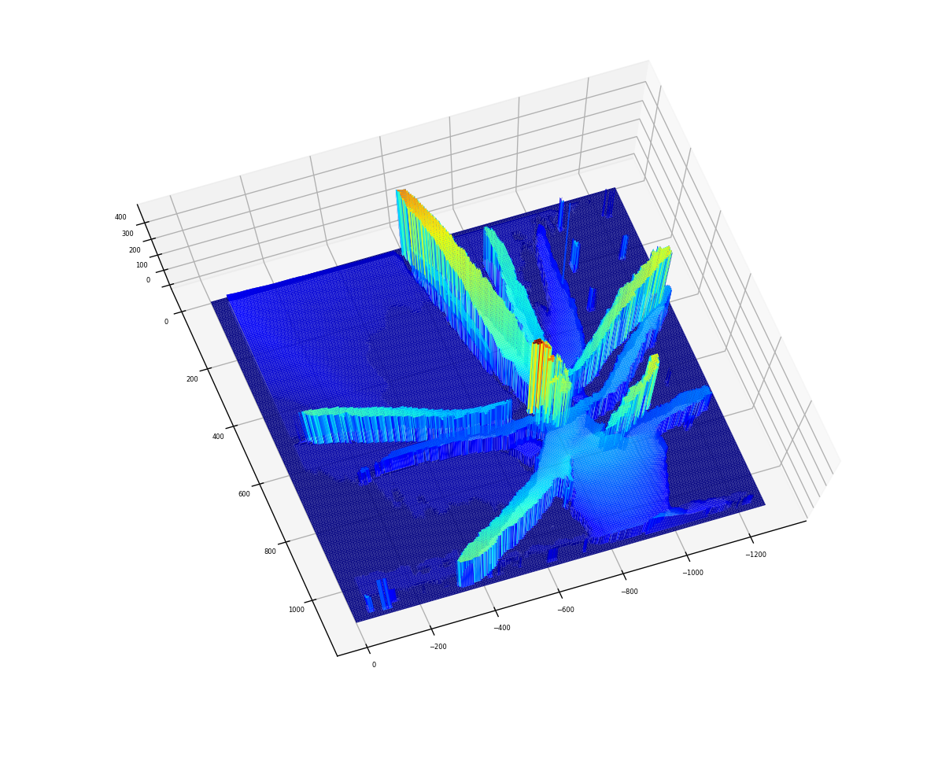
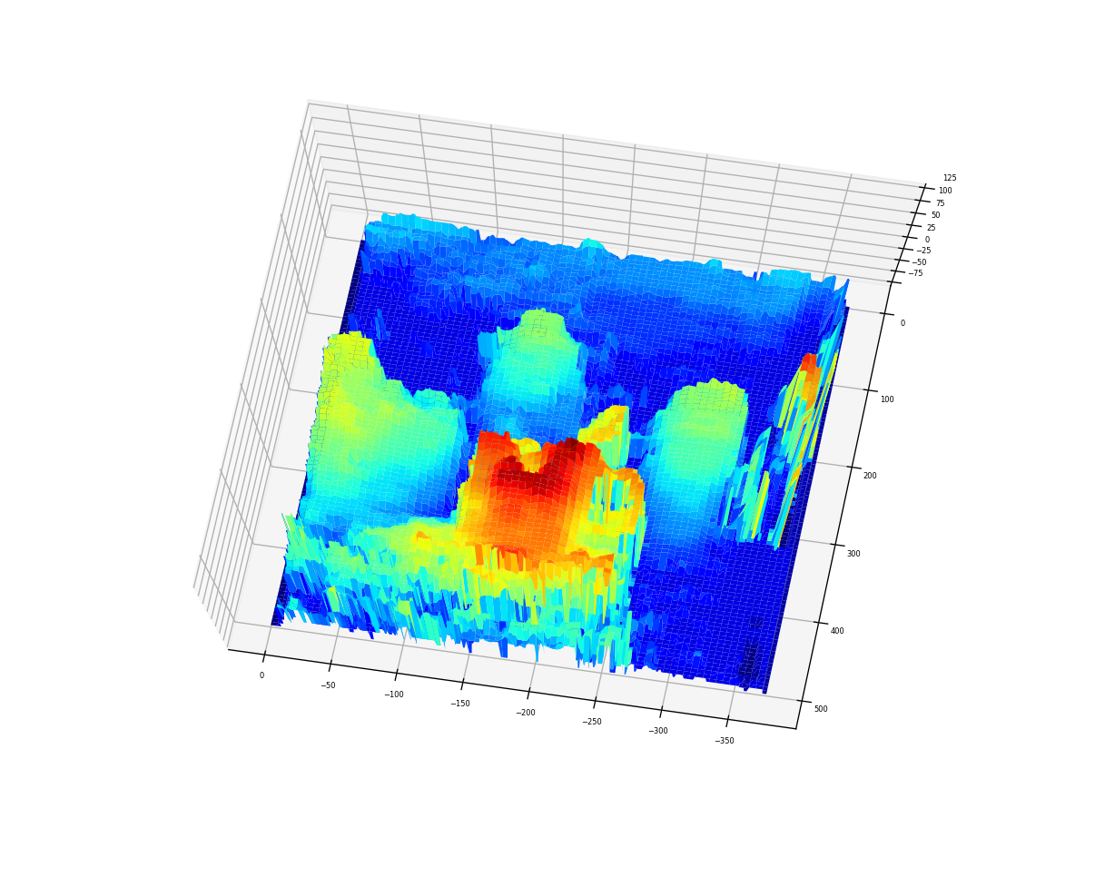
objectives
Align two images of a scene along their epipolar line
Find matching point in a scene pair using feature matching algorithms.
Derive depth information from the image disparity.
Physics-301/Activity 05 - Basic Video Processing.ipynb at main · reneprincipejr/Physics-301 (github.com)
https://drive.google.com/file/d/1S1juRZtkc_vtyp8Ffvfp62fFIImtMSSb/view?usp=sharing

Slide 3
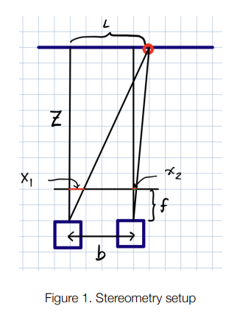
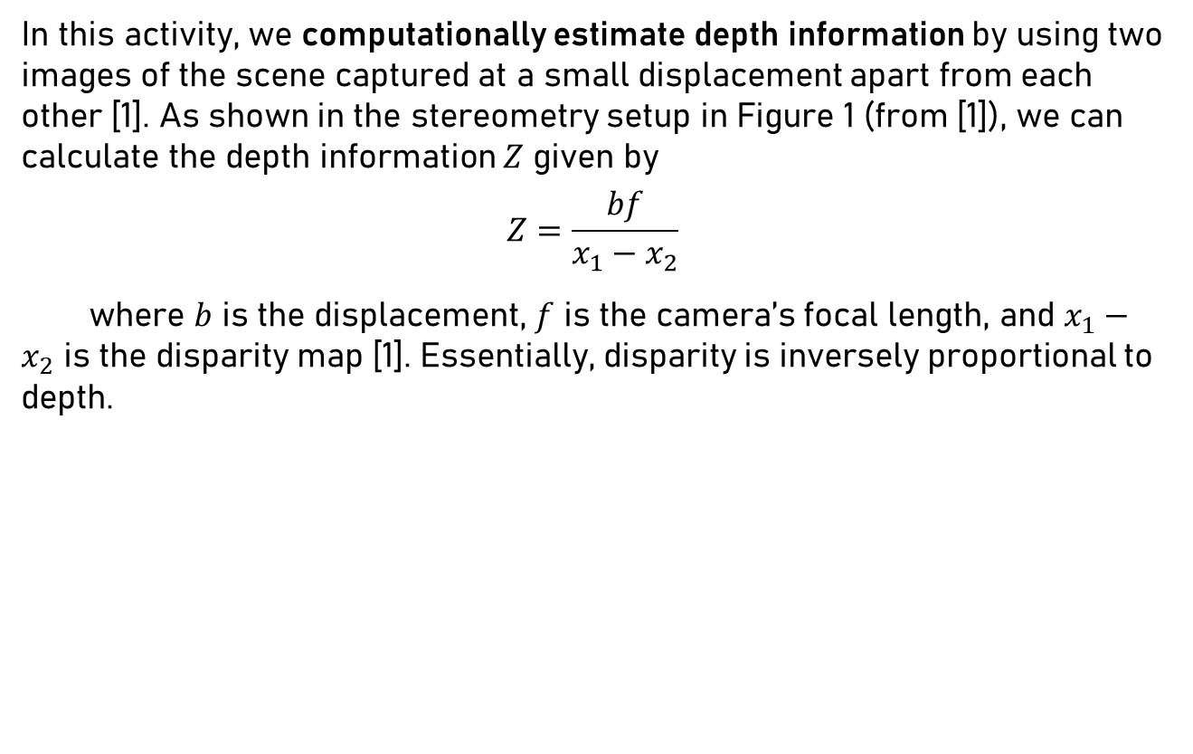
Stereometry
In this activity, we computationally estimate depth information by using two images of the scene captured at a small displacement apart from each other [1]. As shown in the stereometry setup in Figure 1 (from [1]), we can calculate the depth information $Z$ given by
$$Z=\frac{bf}{x_{1}−x_{2}}$$
where $b$ is the displacement, $f$ is the camera’s focal length, and $x_{1}−x_{2}$ is the disparity map [1]. Essentially, disparity is inversely proportional to depth.

Slide 4
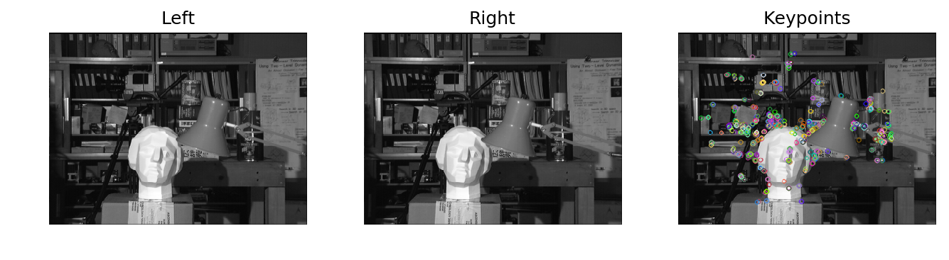
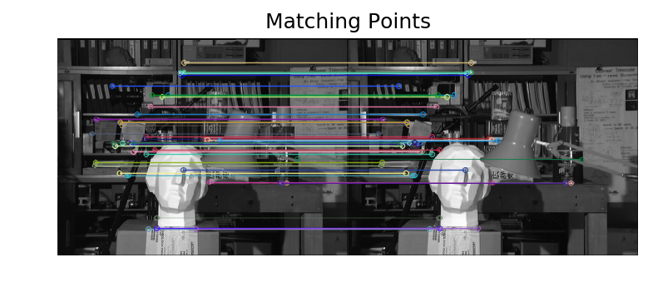
Rectification
We first tested the algorithm on ideal samples from Middlebury Stereo Datasets [2]. In real life, images may be skewed or warped and so, we must get the camera’s Fundamental Matrix to rectify unwanted rotations before we carry on with stereometry. Shown below are the two “tsukubai” images along with the key points detected using FLANN [3].
Here we show the matching key points; features that are identified to be present in both images. These features constitute the fundamental matrix.

Slide 5
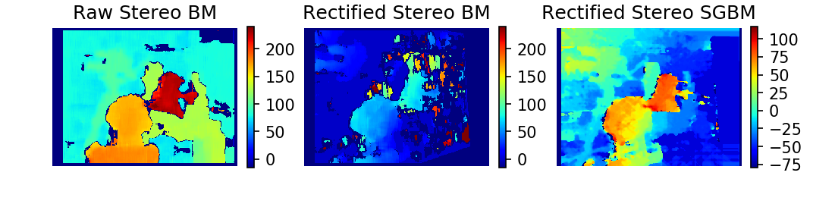
Disparity Maps
Rectification for the uncalibrated camera was carried out using Open-CV’s cv2.stereoRectifyUncalibrated [4]. After distortion-correction, the disparity maps can be calculated using Stereo BM (block matching) algorithm [5]. In addition, we also employed Stereo SGBM (Semi-Global Block Matching) which generates a more “dense and smooth” disparity map [6][7].
Throughout the results, we compare the disparity map calculated between the (1) raw images and (2) rectified images both using Stereo BM and thirdly, using (3) rectified Stereo SGBM. The qualitatively best disparity map shall then be 3D reconstructed. Lastly, we reconcile if the disparity map yielded intuitively explains the scenes’ actual depth information.

Slide 6
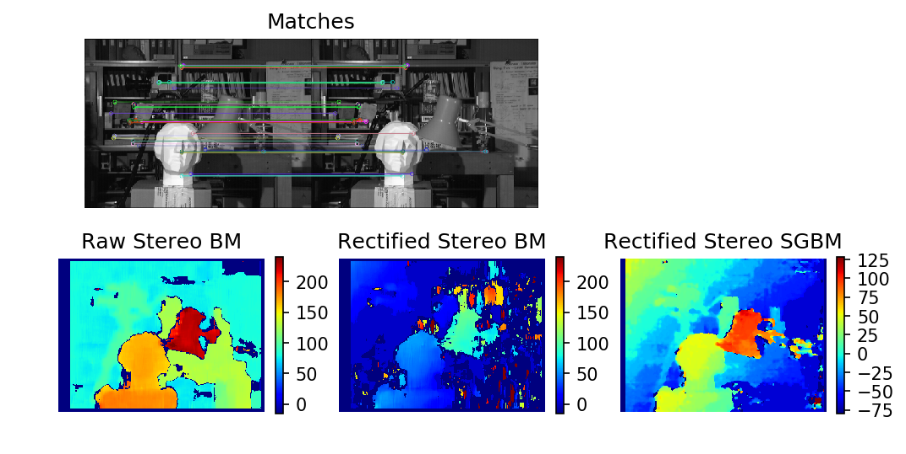
3D: Tsukuba ^{[2]}
Shown is the 3D rendition of the disparity map from the rectified Stereo SGBM, dense and much smoother than what we get from the Stereo BM. As we can see, the lamp had a greater disparity since it is nearer.

Slide 7
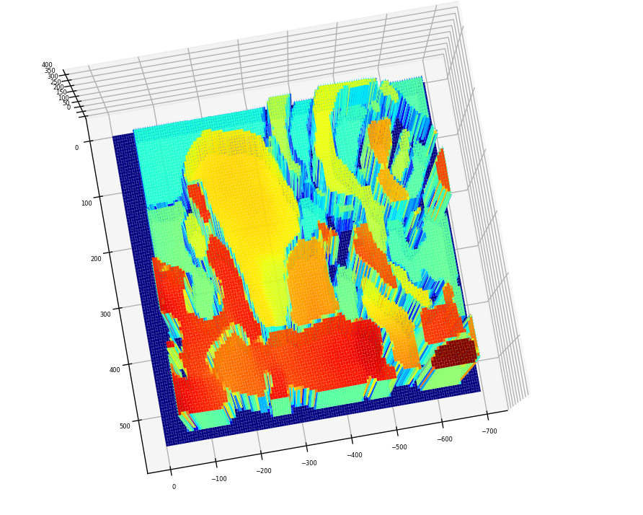
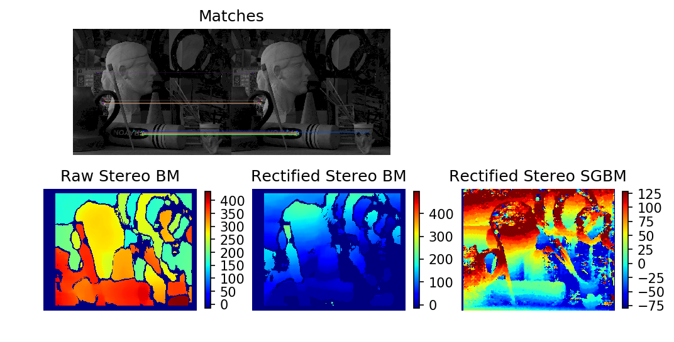
3D: Art ^{[2]}
Among the three, the Raw Stereo BM gave favorable disparity map. The nearby objects show higher disparity and the objects in the background have small disparity as seen by the displaced camera.

Slide 8
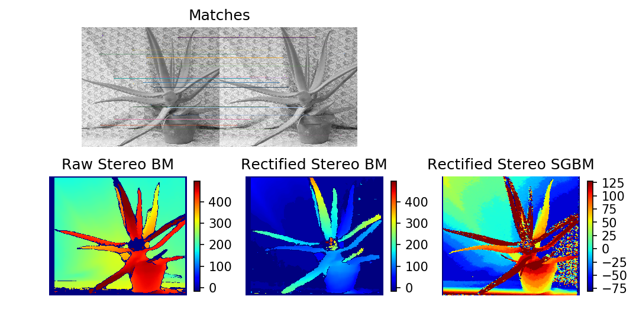
3D: Aloe Vera ^{[2]}
In this example, the rectified Stereo BM returned the best disparity map. In fact, one leaf that’s protruding rendered a very high disparity, which means that it relative nearer than the rest.

Slide 9
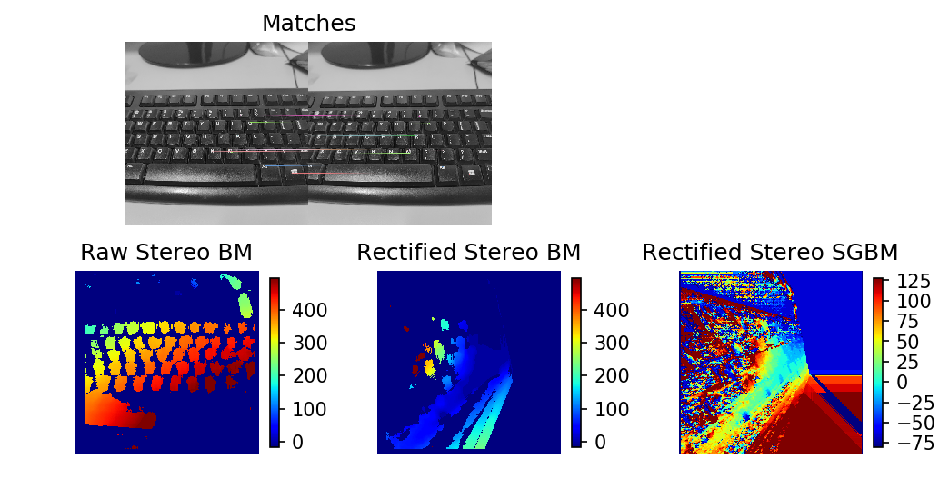
3D: Keyboard
Using images that I took; the raw disparity map was able to differentiate depth information of the keyboard caps that are nearer (red) and farther (cyan). The rectification failed to work on this set.

Slide 10
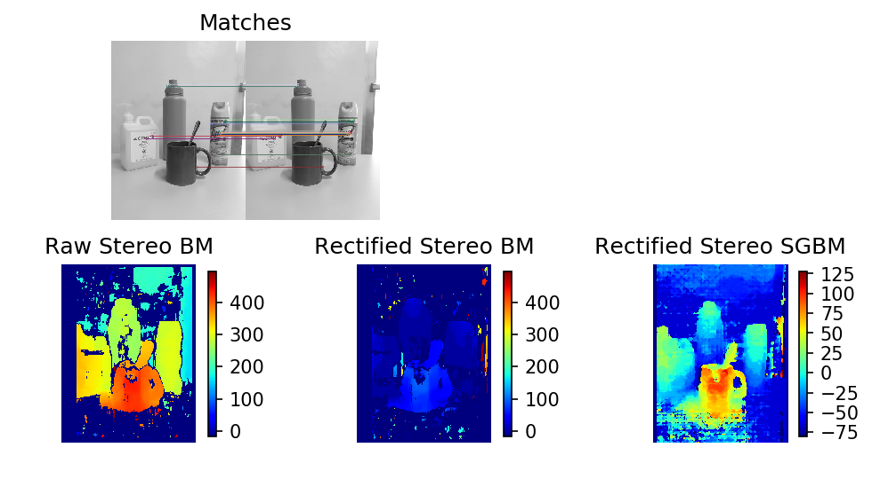
3D: Mug
For this sample, the rectified SGBM returned a good disparity map. We can see that the cup, which is nearer than the rest, had greater disparity. The objects at the back were also separable from the wall backdrop.

Slide 11
reflection
Overall, I enjoyed rendering the 3D objects using Stereometry. Though, it must be mentioned that a lot of trial and error were made in terms of choosing the parameters for the Open-CV functions. It took me quite a long time to grasp the rectification process, especially that on some results, disparity maps are the best even without the rectification process. I haven’t discussed the depth-to-disparity conversion since I’m getting very weird results, and I fundamentally did not know why the disparity maps returned different range of values on three methods. Instead, I associated the disparity information to gain insights about the object's depth in the image scenes. I also tried implementing Stereo SGBM which had smoother disparity maps on some instances.
I feel like I could do a lot more but as of now, I’d give myself a score of 92/100.
[1] M. Soriano, Physics 301 – Shape from Stereo, (2022).
[2] vision.middlebury.edu/stereo/data
[3] Feature Matching — OpenCV-Python Tutorials beta documentation
[4] cv.stereoRectifyUncalibrated - mexopencv (amroamroamro.github.io)
[5] OpenCV: cv::StereoBM Class Reference
[6] Stereo Disparity Using Semi-Global Block Matching - MATLAB & Simulink (mathworks.com)
[7] python - OpenCV – Depth map from Uncalibrated Stereo System - Stack Overflow

